Slide 1
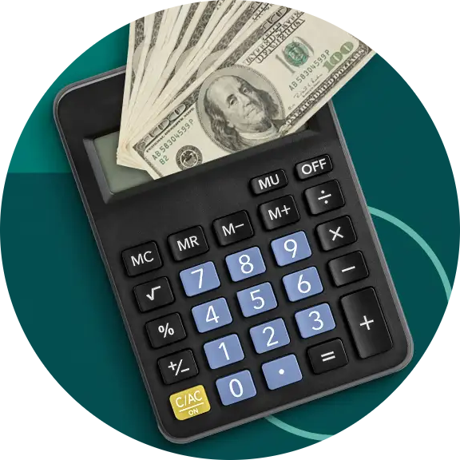
Done by
SANJAY B - 21R234
ARDHANARIESWARAR A - 24I461
LOAN TRACKER

Slide 2
Why Loan Tracker?
Tool for financial calculations: It automates the process of calculating interest on loans, savings, or investments.
Calculates both Simple and Compound Interest: Helps determine the total interest based on the type of interest.
User inputs: Requires inputs such as principal amount, interest rate, and time period.
Saves time: Speeds up complex interest calculations, reducing manual effort.
Improves accuracy: Minimizes errors commonly made in manual calculations.
Provides clear insights: Shows the total amount due or the growth of an investment over time.
Used for various financial decisions: Helps in making informed decisions about loans, mortgages, savings, and investments.

Slide 3
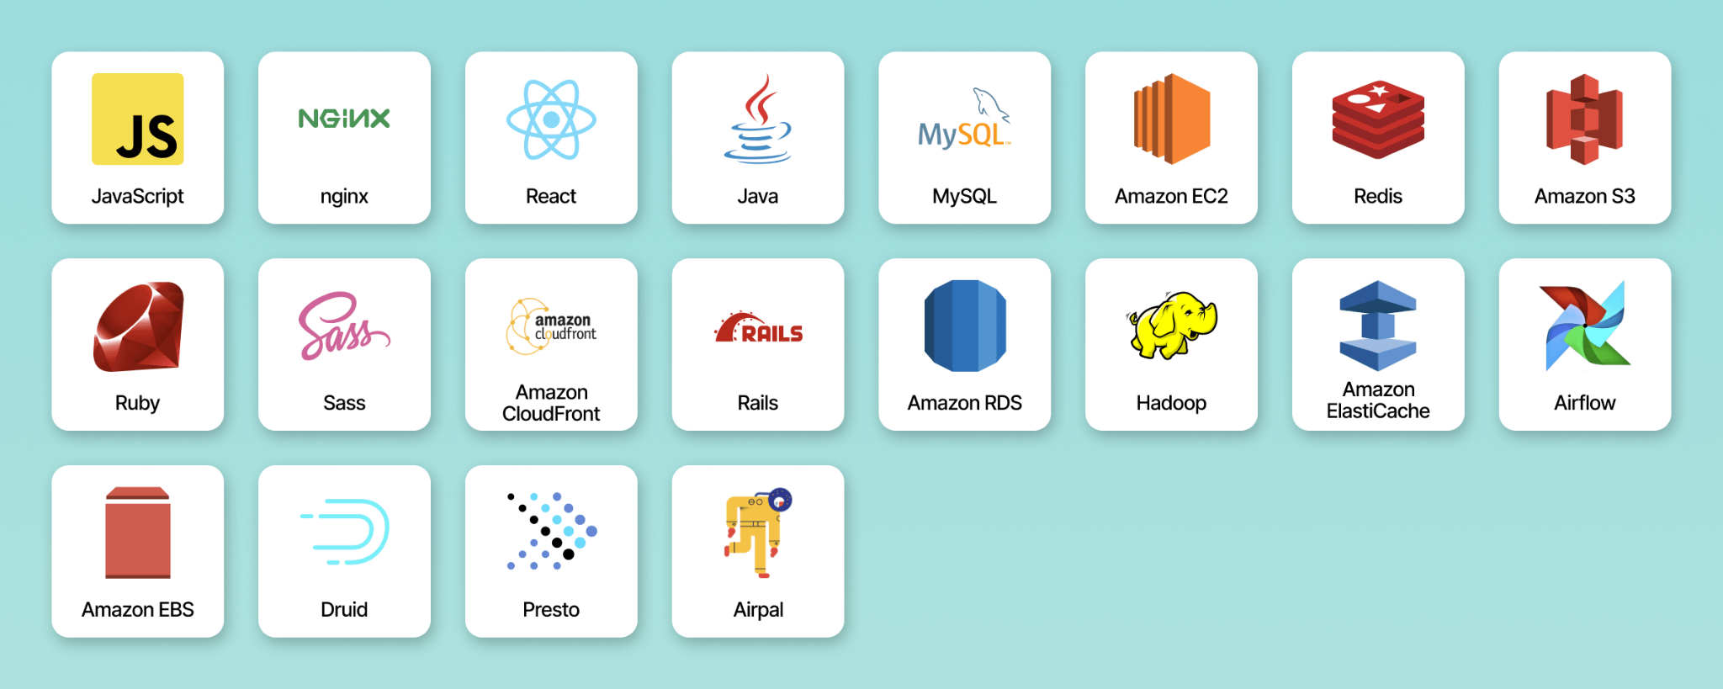
Tech Stack
HTML
CSS
JAVASCRIPT
BOOTSTRAP

Slide 4
Features Implemented
We have implemented a scroll-bar and a pie-chart feature to let the users see the interest rate changes with ease. The users can still input the interest rate and number of years with their keyboard.
The Total Payable amount gets updated in real time so that the users can keep track of what amount they are in debt to the lender.
Flexible Payment method has been implemented, so that the users can pay an amount more than the required interest amount per month. This allows the users to adapt to the change in financial situations. The users can also pay back the full amount within the given time period without any additional penalties.
Fixed Payment method is also available to allow users to get an idea of the amount that they are supposed to pay per month.

Slide 5
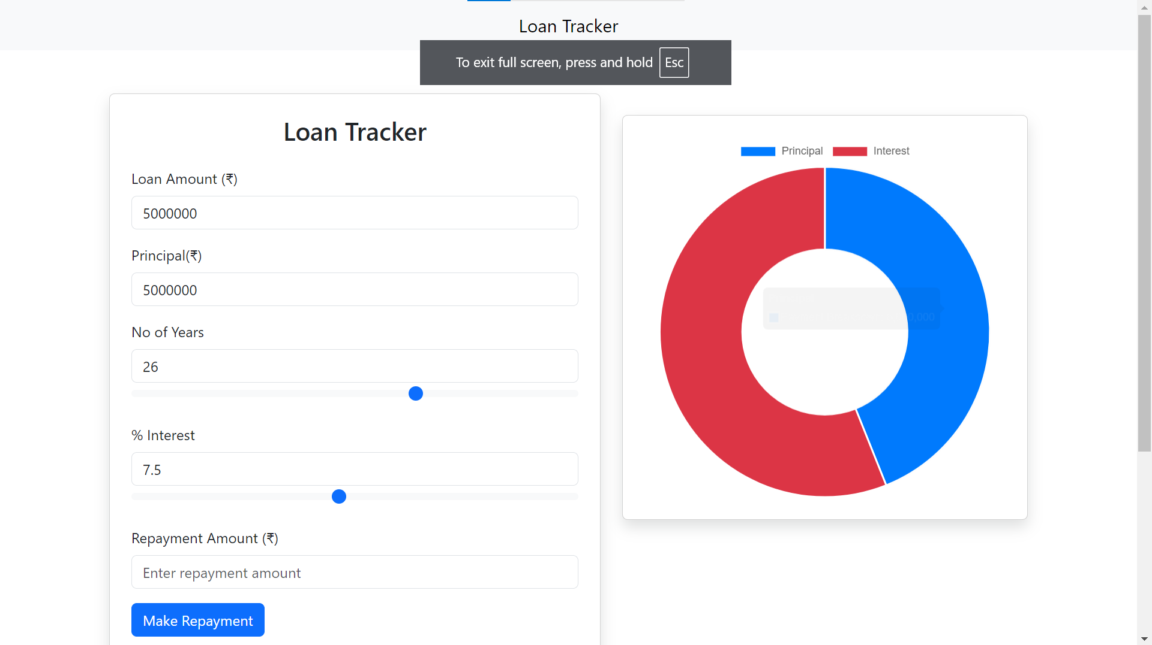
LOAN TRACKER GUI

Slide 6
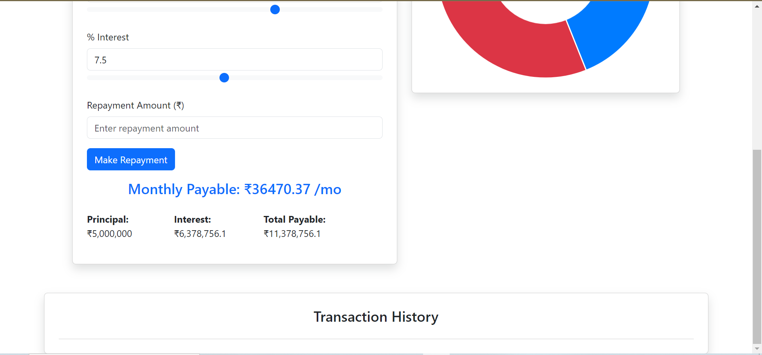
LOAN TRACKER GUI

Slide 7
Future Plans
We plan to use an UPI api to track the user payments directly made through Paytm, GPay, PhonePe, etc..
The activities of both lenders and borrowers can be tracked by storing their details in a database and mapping the borrowers to their corresponding lenders.
A notification will be sent to the borrowers if there is a due date approaching and if the payment for the current month is not made.
A notification will also be sent to the lenders if the particular borrower has made the payment for the month.

Slide 8
THANK YOU !

